Slide 1
CS 401 – ARTIFICIAL INTELLIGENCE
LECTURE 14: GAME THEORY

Slide 2
INTRODUCTION
What is game theory?
Evaluation function
Utility function
Finding optimal solution in a multi player situation

Slide 3
Adversial Search
Competitive strategy
Co-operative strategy

Slide 4
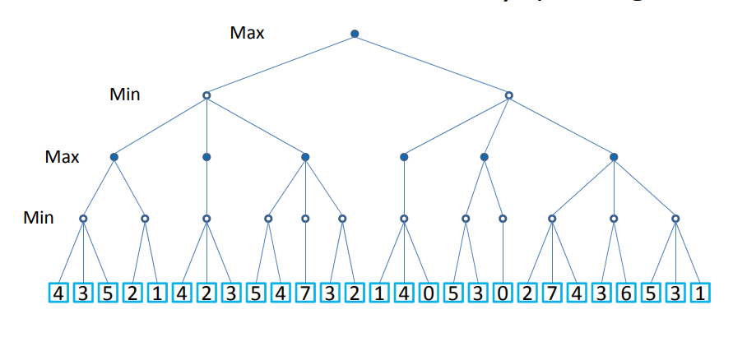

Slide 5
eg
3
12
8
2
4
6
14
5
2

Slide 6
eg
3
3
2
2
3
12
8
2
4
6
14
5
2

Slide 7
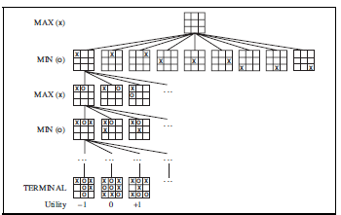
Tic tac toe example

Slide 8
TIC TAC TOE EXAMPLE WITH A RANDOM INITIAL STATE GIVEN
0 | 0 | X
X |  | 0
 |  | X

Slide 9
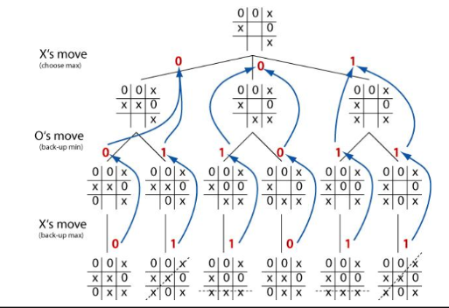

Slide 10
Case no. 1
You and Jess are two criminals, and now its time for some interrogation however both of you do not come in any kind of contact whatsoever. Both of you don’t want to end up rotting in jail, obviously. Now here are the rules of the game decided

Slide 11
If you plead not guilty and Jesse confesses (defects), Jesse will be released and you might have to stay in the jail for twenty years.
Similarly, if Jesse pleads not guilty and you confess, you will be released and Jesse might have to stay in the jail for twenty years.
If nobody makes any implications and hold their ground (i.e. both co-operate), both might receive the maximum sentence of six months (good!)
If both of you decide to plead guilty and implicate the other (i.e. both defect), both will receive a sentence of eight years (not so good).

Slide 12
Solution
?
NG
G
G
(8,8)
NG
(0,20)
G
(20,0)
NG
(0.5,0.5)

Slide 13
Consider two technology giants who are deciding between introducing a radical new technology in memory chips that could earn them hundreds of millions in profits, or a revised version of an older technology that would earn them much less. Thus, if both companies decide to introduce the new technology, they would earn $600 million apiece, while introducing a revised version of the older technology would earn them $300 million each. But if Company A decides alone to introduce the new technology, it would only earn $150 million, even though Company B would earn $0. On the opposite, if Company B decides alone to introduce the new technology, it would only earn $150 million, even though Company A would earn $0.

Slide 14
ALPHA BETA PRUNING
Is it necessary to visit entire tree in order to find solution?
α= the value of the best (i.e., highest-value) choice we have found so far at any choice point along the path for MAX.
β = the value of the best (i.e., lowest-value) choice we have found so far at any choice point along the path for MIN.

Slide 15
eg
3
12
8
2
4
6
14
5
2

Slide 16
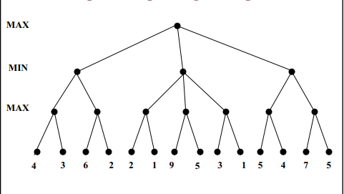

Slide 17
SOLUTION (pruned ones marked only)

Slide 19
SOLUTION (pruned ones marked only)

Slide 20
Can there be any further betterment?
We can further cut down more nodes.
Optimization technique
Best case: Each layer best node left-to-right
Concept known as move ordering

Slide 21
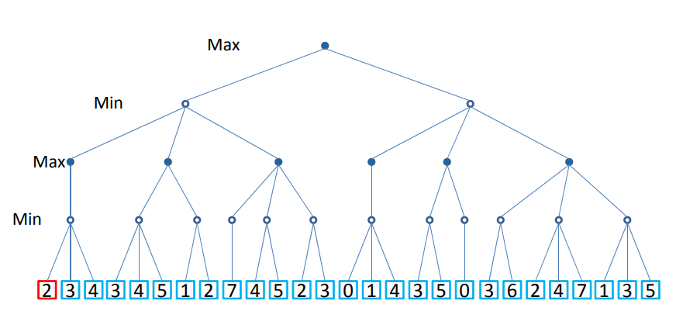

Slide 22
SOLUTION (pruned ones marked only)

